Slide 1
Evaluation of a Public Health Pathway for Users of Alcohol and Substances in the Criminal Justice Setting
Final Report
April 2023

Slide 2
PHIRST South Bank
PHIRST South Bank is one of six Public Health evaluation centres funded by National Institute for Health Research (NIHR).
The aim of these Centres is to provide timely and robust evaluations of locally led interventions to both inform future local decision making and contribute to an evidence base that is useful to the wider public health community.
PHIRST South Bank is led by staff at London South Bank University (LSBU) and brings together an interdisciplinary team that have a wealth of experience of working with local authorities across a wide range of public health priorities.
The Centre is based on a principle of co-production with local stakeholders and it is intended that the joint working between local authorities and our academic team will result in greater mutual understanding, learning of new skills and will ensure evaluations are relevant and useful.
Patient and public involvement is central to the Centre’s approach and lay representation is embedded throughout the infrastructure and delivery of our work.

Slide 3
Approvals & Declarations
Ethical approval was secured from the School of Health and Social Care Ethics Panel at London South Bank University (ETH2122-0131and ETH2122-0176). Centre ID: NIHR131568; Award ID; NIHR135411.
The authors declare that they do not have any commercial or financial relationships that may result in a conflict of interest.
The views expressed represent those of the authors and not necessarily those of affiliated organisations.
https://fundingawards.nihr.ac.uk/award/NIHR135411

Slide 4
Evaluation Contributors
The PHIRST Team:
Professor Eddie Chaplin (PI) Professor of Mental Health in Neurodevelopmental Disorders
Dr Thomas Mills (PI) Public Health Research Fellow PHIRST South Bank
Dr Manuela Jarrett Assistant Professor, Mental Health Nursing, University of Birmingham
Dr Jaimee Mallion Senior Lecturer, Psychology
Denise Harvey Senior Lecturer, Social Work
Professor Susie Sykes Professor in Public Health and Health Promotion, PHIRST South Bank Director
Professor Jane Wills Professor of Health Promotion, PHIRST South Bank Knowledge Mobilisation Lead
Sarah Quilty Senior Public Health and Commissioning Manager
Nicola Wade Commissioning Manager Nottinghamshire Office of the Police and Crime Commissioner
Funding: This evaluation was funded by the National Institute for Health Research.
Acknowledgements: Thank you to our participants for taking part and our Local Authority Partner, Public Health Division Nottinghamshire County Council, for supporting this evaluation.

Slide 5
Abbreviations
ARS – Arrest Referral Scheme
CGL – Change, Grow, Live
DIP – Drug Intervention Programme
NHS L&D - National Health Service Liaison and Diversion
PH – Public Health
OPCC – Office of the Police and Crime Commissioner

Slide 6
The Intervention and Background

Slide 7
The Intervention: a pilot public health pathway for users of alcohol and substances in the criminal justice setting
Public Health (PH) Commissioning for Nottinghamshire and Change, Grow, Live (CGL) – the local substance misuse provider – developed a new pathway concept following disruption during the Covid-19 period. Up to that point, the local service had been a continuation of the Drug Intervention Programme (DIP) with PH Commissioning and Nottinghamshire Office for Police and Crime Commissioner (OPCC) sharing commissioning responsibilities.
The pathway concept aspired to create a personalised service that would more efficiently utilise staff resources and better coordinate services with positive outcomes for both service-users and staff. It was based on a new triaging system that would see service-users offered interventions at three levels:
  Level 1 – brief health advice to be universally provided, including brief alcohol advice
  Level 2 – service-users to receive the standard treatment service, either on a voluntary or mandatory basis
  Level 3 – assertive outreach to engage the most prolific of offenders
The pathway was still at the inception stage at the beginning of this evaluation, allowing an examination of the implementation and development process.

Slide 8
A changing policy and service context…
Interventions for diverting service users from criminal justice into treatment have increased since the 1970s: the US-based, ‘Treatment Alternatives to Street Crime for Safer Communities’, is one of the first examples
In the UK, Arrest Referral Schemes (ARS) have existed from the 1980s onwards while the Drug Intervention Programme (DIP) was implemented nationally in 2003:
  DIP targeted heroin and crack cocaine with drug testing on arrest and the option of mandatory referrals into treatment; case management utilised to provide a tailored package of support for service-user needs
  DIP ended as a national policy in 2013: some local public health and police forces have continued DIP investment
NHS Liaison and Diversion was launched as a national service in 2014 and has since achieved national spread. This focuses on identifying and supporting people with vulnerabilities through the criminal justice system, which can include substance misuse vulnerabilities

Slide 9
A changing policy and service context cont…
Dame Carol Black was commissioned in February 2019 by national government to undertake an independent review of drug policy. This review was critical of government policy since DIP’s end in 2013, stating: the “public provision we currently have for prevention, treatment and recovery is not fit for purpose”
The ‘From Harm to Hope: A 10-year drugs plan to cut crime and save lives’ policy paper was introduced in response to Carol Black’s report. This outlined new investment and ambitious targets for diverting service-users from the criminal justice system into treatment.
Currently, local provision is a mixture of ARS and DIP in the custody suite with considerable variation across settings (Sondhi and Eastwood, 2020)
Local collaboration between NHS L&D and substance misuse services is expected with referrals (HM Gov, 2021)

Slide 10
Existing literature: what did we know already?
Evidence for diversion schemes for diverting service-users into treatment:
  Evaluations of the UK’s Drug Intervention Programme (DIP) suggests that offending reduces when people are in treatment for substance misuse with some studies suggesting this effect continues for six months after DIP contact – this evidence is not considered gold standard, however (Skodbo et al, 2007; Sondhi and Eastwood, 2020)
  Debate is ongoing about the mandatory component of DIP: some argue that mandation can be useful as a first route into treatment, but studies have questioned whether mandation is better than voluntary approaches at facilitating service-user engagement (McSweeney et al, 2016)
  A recent study suggests that it is quality of the treatment service, including whether care is personalised, which is key to sustaining service-user engagement (Sondhi and Eastwood, 2020)

Slide 11
Existing literature: what did we know already?
Evidence for alcohol brief interventions for custody:
  Evidence of effectiveness in a range of health settings but evidence in criminal justice settings is lacking: a review found no “substantial, robust and consistent” (Page et al, 2019)
  Alcohol Arrest Referral (AAR) – introduced in four police forces in 2007 with alcohol referral workers delivering brief interventions on a voluntary basis: no evidence of reductions in re-offending rates but some evidence of reductions in alcohol consumption (Blakeborough and Richardson, 2012)
  Barriers to delivery include the degree of intoxication of detained individuals; competing priorities in a pressured service environment; the motivation and skills of staff (Best et al, 2002)
  Qualitative research involving custody suite staff in a feasibility trial of an alcohol brief intervention found role legitimacy issues with public health agendas not always viewed as a priority: the authors call for interventions that integrate the role of care in addressing drivers of crime and national policy effort to train and motivate police staff in public health roles (McGovern et al, 2020)

Slide 12
Existing literature: what did we know already?
Evidence for vulnerable groups:
NHS L&D supports people with vulnerabilities in the criminal justice system and has achieved national implementation since its creation in 2010. The service operates in the custody suite and a role in substance misuse assessment and referrals is anticipated nationally (HM Gov, 2021). It is therefore important to consider the findings of a recent RAND evaluation which found:
NHS L&D appears to reduce the likelihood of custodial sentence although there has been no impact on re-offending
88% referrals to NHS L&D have at least one vulnerability identified, with half having alcohol or substance use issues
Detainees with alcohol and substance use most likely to decline NHS L&D referral and interventions
Wide variation exists in the numbers of substance misuse referrals between sites
Both NHS L&D and police report insufficient resources to meet need
Integrated working locally is hampered by underdeveloped information sharing protocols with considerable variation between sites (Disley et al, 2021)

Slide 13
Co-producing the Evaluation

Slide 14
Co-producing an evaluation plan
A series of co-production workshops were carried out to reach a shared understanding of:
  the aims and processes of the intervention
  a logic model and theory of change underpinning the intervention
  the existing evidence and gaps in knowledge
  an evaluation question that was feasible and useful to both the local intervention and the wider public health community
  an appropriate evaluation design plan
Representatives from: Nottinghamshire County Council, CGL, Nottinghamshire Police, Nottinghamshire OPCC, Nottinghamshire Probation Service and service users participated in the workshops
Joint decision-making continued following this formal process around specific aspects of the protocol
The workshops produced a logic model of stakeholders’ initial ideas to guide the evaluation design. This model is described in the next slide and then presented in the slide that follows

Slide 15
Logic model description
Because the pathway was only a concept at the start of the evaluation, adaptations to the activities were anticipated with an implementation strategy planned to facilitate these – this is described in the ‘implementation strategy’ column of the model on the next slide
The pathway concept implied new health-related activities for some staff: police custody suite staff would, on entry into custody, assess service-users for their suitability for one of three levels of intervention:
  At level 1, police custody staff would provide brief information in the form of a tailored, wellbeing pack, including alcohol information where appropriate
  They would also refer service-users for treatment at level 2, which could include voluntary or mandatory referrals: level 2 was CGL’s standard treatment offer
  Police custody staff could also identify a small number of regular users of the custody suite who they wanted CGL to work more closely with at L3
A working assumption was that, with custody police staff doing more to assess and refer on entry into custody, CGL workers could focus on preventative, outreach work in the community. This may involve multi-agency collaboration with input from neighbourhood police, although the outreach component of L3 was the least developed of the three levels
It was anticipated that the new pathway, when implemented, would achieve diverse outcomes, ranging from increased uptake and enhanced service-user engagement to reductions in the social cost linked to substance misuse – these are described in the various outcomes columns

Slide 16
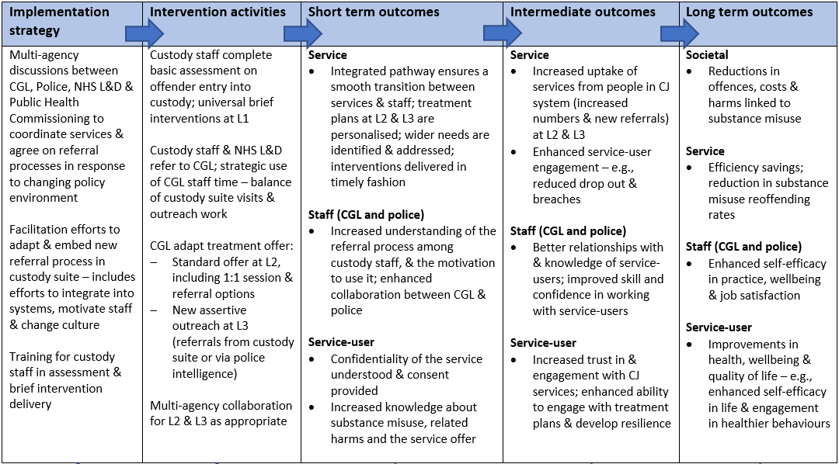
Co-produced logic model of pathway concept

Slide 17
Revisions to planned pilot implementation and evaluation
The original protocol had two phases; an initial implementation evaluation as the substance misuse criminal justice pathway was established followed by an evaluation of its use including views of service users and providers
Challenges to implementation of the pilot pathway meant it was not live within the timeframe of the evaluation
Revisions were made to the original protocol to reorientate the research to exploring and understanding current arrangements and to assessing the local partners’ planned pathway with a view to developing this for future implementation
The revised research questions are on the next slide

Slide 18
Research questions
The project aimed to evaluate the pathway concept via the following questions:
How is a public health pathway for alcohol and substance users in the criminal justice setting developed and implemented?​
Does it have potential to achieve: co-ordination between services, acceptability, engagement and short-term outcomes?​
Research objectives:
To explore the context and the process of development and early implementation of the pilot
To explore the experience, acceptability and perceived impact of current arrangements and proposed changes among service providers

Slide 19
Evaluation Design
Data collection
  11 in-depth qualitative interviews with senior staff of key stakeholder agencies (PH Commissioning, CGL, OPCC and the police) as they developed and implemented the pathway
  14 in-depth qualitative interviews with frontline staff (including police, CGL and NHS L&D) to explore their views on the pathway concept, current arrangements and any changes implemented
Data analysis
  Framework analysis – included a focus on staff perspectives on the pathway concept
  SWOR-informed situation analysis (Strengths, Weaknesses, Opportunities, Risks) – to assess the custody and community settings for the pathway concept

Slide 20
Rationale and relevance
This evaluation has broad relevance to PH Commissioning, OPCC, substance misuse providers and the police force given the heightened interest in criminal justice pathways into treatment following Dame Carol Black’s report and the ‘From Harm to Hope’ policy paper
The diversity of local services necessities detailed qualitative research to draw out the learning from an attempt to coordinate services, with the evaluation showcasing an effective collaboration with local partners and PHIRST South Bank
Establishing best practice in terms of how to engage service-users at the interface of the custody suite and treatment is vitally important as substance-related crime may be increasing at significant cost to those directly affected and the wider society (Allen and Tunnicliffe, 2021)

Slide 21
Evaluation Findings

Slide 22
Findings:
Section 1: Implementation of pathway concept

Slide 23
Implementation of pathway concept
The proposed pathway was not implemented despite significant local effort. Implementation challenges included:
Enhanced police activities in substance misuse assessment and brief intervention delivery were not implemented because custody staff lacked confidence. Some police staff were concerned that they might overpromise CGL’s offer because they did not know what this entailed. Custody police staff also reported service pressures that made it difficult to adopt new processes and high staff rotation meant that initial successes were short lived
A referral process for NHS L&D was already integrated into police systems and was the default option for custody police staff
Increased national policy funding for new staff roles led to considerable local staff churn with three CGL custody suite workers moving post which stalled implementation efforts
The custody suite was closed for refurbishment for a 3-month period during implementation
Community referral processes also remained underdeveloped amidst a rapidly evolving policy and service context

Slide 24
Findings:
Section 2: Staff roles and views of public health

Slide 25
Introduction
In the absence of an operational pathway, we explored the various staff roles that contribute to the identification, assessment and support of service users who use substances. Of the various frontline staff groupings – including custody police staff, CGL staff and NHS L&D – each group made substantial and unique contributions, although the adoption of enhanced health activities by custody police was complicated by their need to balance this with authority and risk-management roles. Nevertheless, we found broad consensus on the need for a public health approach to substance misuse among frontline and senior staff.
The findings reveal consensus on the importance of a substance misuse worker role in custody, although there was recognition that a permanent presence may not be an optimal use of resources. Skill gaps (among police staff and NHS L&D) were highlighted as reason for why substance misuse workers are vital, as well as more intangible contributions in identifying, and developing relationships with, service-users on an informal basis who may have been missed in initial police assessments. Staff and service pressures were reported across all staff groups which presents challenges to service improvement efforts.

Slide 26
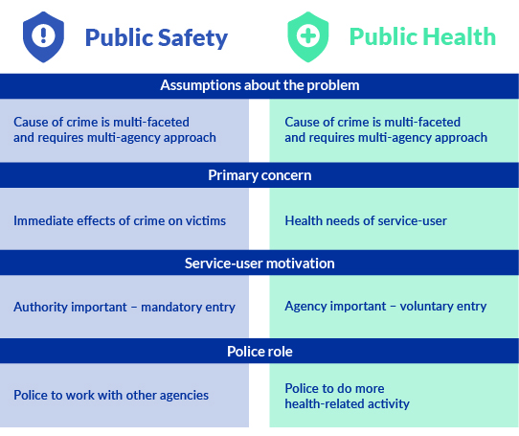
Stakeholder views – public safety vs public health
It is sometimes said that public health and police perspectives conflict, with the latter emphasising public safety. By contrast, our interviews revealed broad consensus on the need for a public health approach to crime prevention. Stakeholders agreed on the importance of a preventative, multi-agency approach but police and public health perspectives did differ, with differences on whether service-users should be mandated into treatment and the role of the police in a public health approach.

Slide 27
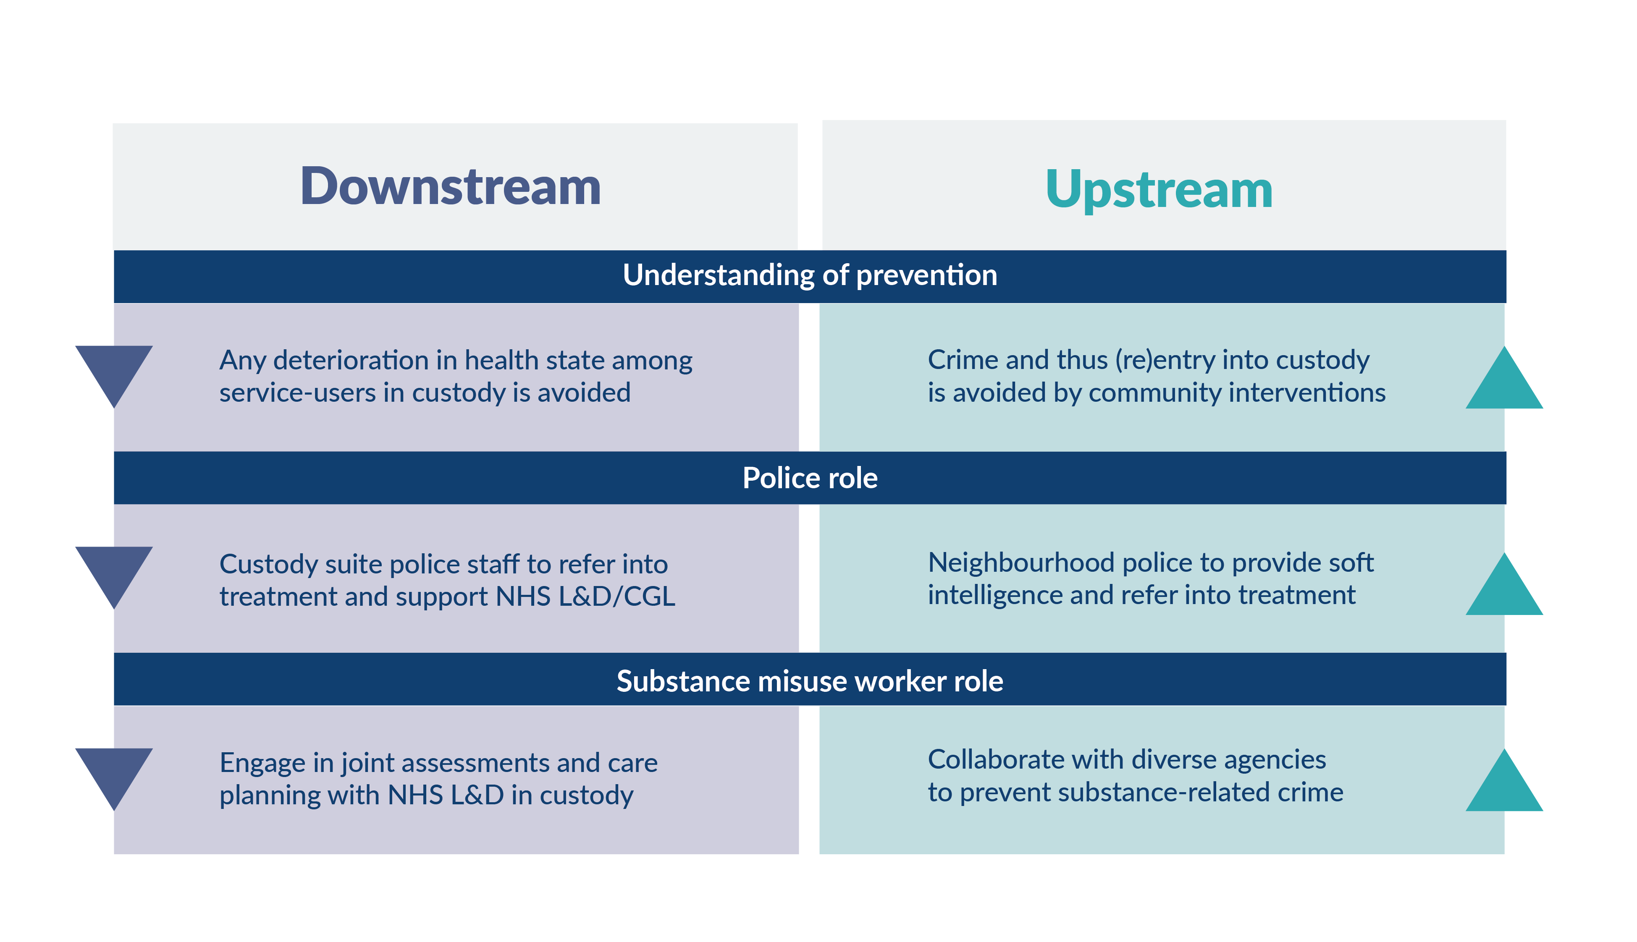
Stakeholder views – downstream vs upstream prevention
As well as the broad differences between public health and public safety perspectives, there were subtle differences in stakeholder’s understandings of prevention even when they adhered to a public health frame, with upstream and downstream variants. This is significant because it warns against the view that only interventions in the community are preventative. Custody suite interventions can initiate contact with people with complex health needs and prevent further deterioration in health from occurring.

Slide 28
“
The challenge is to merge different outlooks across the criminal justice and public health sectors:
Some of the criminal justice sector say, ‘These people are committing crime. We need to arrest them’ …. Looking at it from a public health perspective, there’s a reason why these people are misusing substances: we need to help them and engage with them and bring them into treatment. Arresting people multiple times isn’t going to change behaviour … We are on two different train tracks and it’s how we can sort of merge a little bit around the fundamentals around those who commit crime, who misuse substances as well
”
“
A police person describes why their view has changed overtime:
As a young police officer there’s nothing more satisfying than when a perceived baddie, someone who’s causing chaos and carnage in the city centre [is arrested]: you arrest them, you detain them, you take them into custody, you interview them for whatever relevant offence, they are processed, they’re charged, they’re either remanded or they go to prison. And you’re thinking: ‘I’ve done a good job there: that’s what my job is about’. And that is part of a police officer’s role, but then when you see that same person bounce out of prison in very short order … and then it happens a third and a fourth time, clearly there is something going wrong if they are just repeating those offences time and time again
”

Slide 29
Frontline roles and contributions: CGL
CGL staff were not present in custody during the evaluation so it was not possible to explore what they currently do to support service-users in the environment
Frontline CGL workers had a nuanced perspective on the key question of whether a substance misuse worker should be embedded within custody:
  On the one hand, they recognised that time in custody was not always well spent due to low footfall and because many service-users present in custody are already known to the service. Some highlighted challenging workloads and preferred to work more proactively with their existing client base in community settings, with a suggestion that this could achieve greater impact
  However, they also highlighted the unique advice and support substance misuse workers provide when needed, and one stated a preference to be there “ideally five days a week”. Substance misuse workers can engage service-users whose health needs have been missed in initial police assessments by doing informal “cell sweeps”. Being present in custody also creates opportunities to catch up with service-users who are already known to the service
Frontline CGL workers identified barriers impacting on their work, including staff and service pressures, lack of information sharing between agencies, the fast turnover of service-users and excessive paperwork

Slide 30
“
CGL workers have contrasting views on the value of working in custody:
We will go into custody and see who’s in the custody cells, and quite often that’s people we already know that are already in service so it gives us an opportunity to catch up with them, if they’re not engaging and see why they’re not engaging, while we’ve got them in that environment where they can’t get rid of us really, they can’t escape. It’s nice to have them there to catch up with them and see what the barriers are
”
“
We pulled back into a community model. We got rid of the working from the custody suite because…we might have been seeing a couple of service users…a lot of those were already known to CGL
”
Substance misuse workers bring intangible benefits to custody, including picking people up through “cell sweeps”:
“
The booking in process is not therapeutic: it’s not confidential…There’s a dozen people stood there, watching, while someone’s being booked in. I would say that, quite a lot of the time, a lot of people will not disclose … [information to the police because] they will probably think that they’ll get into trouble for disclosing something, even though it’s not part of their arrest…We’ve had more success by doing our own – a bit more confidential and private – cell sweeps, when the person’s been in their cell
”
Notes:
Recommendations for interagency training:
“Provide training to staff in the custody suites around drugs and alcohol and in that sense, having education around the impact, the services available, what can happen to people when referrals are made, how they can identify issues, what basic advice you can give, that then helps the whole environment and then you’re in a more positive frame of work.” (SS6)

Slide 31
Frontline roles and contributions: the police
Police custody staff activities are process driven, with an initial assessment of service-users carried out during check-in and logged onto the data system (‘Niche’). Some referrals are made onto NHS L&D and CGL but numbers are low and the default option is to refer to NHS L&D because that pathway is embedded on Niche; referrals create work and police staff are confused about differences between NHS L&D and CGL
Police custody staff would prefer to have a drug worker permanently present in custody. They lack the confidence, motivation and skill to take on an enhanced assessment and referral role
Police custody staff report that negative perceptions of the police, among service-users, make it difficult for them to glean information on health needs when there are not obvious signs of drug or alcohol addiction: in their view, relying on police to refer into NHS L&D or CGL may therefore entail unmet need
Police custody staff manage authority and caring roles which can sometimes clash; public health roles may come more naturally to neighbourhood police than to custody staff because of similarities between public health perspectives on crime and community policing
Neighbourhood police have intelligence on problem areas and people with substance misuse needs that may be utilised if relationships with CGL and pathways were developed here; mandatory referrals could be generated through Public Protection Notices

Slide 32
“
A police perspective on the importance of a substance misuse worker in custody:
When they’re in custody, often…the police may not have that great relationship with the individual…[because] we’ve taken away their liberty, which is detain them for doing wrong or suspecting them of doing wrong. And, actually, an independent person, doing that interaction or intervention around substance misuse – someone who understands the individual to actually gain some trust to then say, ‘Right. You’d benefit from support’
”
“
On balancing authority and caring roles in the custody suite:
I’ve spoken to quite a few different sergeants and detention officers and they’ve said exactly the same: it’s difficult to switch from being the ‘jailor’ to being someone who wants to help them. And I think it’s a real skill. Some people are able to do that and some people just can’t or the service user’s just not receptive to that
”
“
On public health roles coming more naturally to neighbourhood policing:
We’ve kind of always done it…because, we, very often, are the eyes and ears: we see people out in the communities…out-and-about in their natural habitats…so get that first sight of them…Neighbourhood policing teams…should be able to identify people who’ve got issues or require support. And, if they’ve got a means to directly refer them in…they [would] take that
”

Slide 33
Frontline roles and contributions: NHS L&D
NHS L&D operate in the custody suite 7 days-a-week – they assess and support service-users for diverse vulnerabilities, including substance misuse; staff provide support in the community for some service-users who have entered the service via custody
NHS L&D receive voluntary and mandatory referrals from custody police staff with cell sweeps sometimes undertaken to pick up anyone missed, although these don’t occur as frequently as CGL workers; NHS L&D sometimes refers service-users onto CGL via an internet webpage
NHS L&D report good working relationships with CGL and give examples of effective joint assessments undertaken in custody that enable service-users’ needs to be assessed holistically – this can enhance the coordination of services with long waiting lists and means that service-users are not asked the same questions by different agencies
NHS L&D workers typically have a background in nursing and mental health and thus lack advanced knowledge of substance misuse and CGL’s treatment offer; NHS L&D workers also don’t have access to information on past interactions between service-users and drug treatment services which, they say, is useful to know when having discussions with service-users who have substance misuse needs

Slide 34
“
CGL and NHS L&D collaborating in the past:
Quite often we’ll do a cell visit together and we’ll tie it in together. That stops two or three people going up to the cells [separately], all asking maybe the same questions
”
“
The requirement of substance misuse knowledge and skills in custody plus NHS L&D training need:
There are discussions and queries about people on methadone and there are different scripts. I’m not a specialist in any of that kind of thing and the different systems and where to get it from and signpost. I think having somewhere with that knowledge based in custody would be an advantage
”
NHS L&D workers lack knowledge of past service interactions – implies need to understand interface between police (NICHE) and drug and alcohol (CRIS) service databases:
“
Sometimes when … [a service-user] is telling us that they are working with CGL and they might not be sure when their next appointment is or they can’t recollect who the worker is, sometimes we say is it okay if we try and ring CGL and find out why you’re in here and we do. I totally understand it confidentiality-wise but sometimes they won’t share that information with us so sometimes we won’t even know whether they are actually an existing open referral with CGL
”

Slide 35
Findings:
Section 3: Assessing the custody and community settings as entry points into treatment

Slide 36
Introduction
This section builds on the analysis of frontline staff roles and contributions to set out the strengths and weaknesses of the custody and community settings as entry points into treatment. By community setting, we mean those settings that are external to the custody suite that present opportunities for upstream intervention prior to service users’ entry into custody through interagency work involving neighbourhood police, CGL and other relevant agencies (e.g., youth services).
The findings suggest strengths and weakness across both settings, with custody offering a reactive model oriented to downstream treatment and prevention; by contrast, the community setting presents opportunities for upstream prevention but lacks established organisational relationships and pathways into treatment.

Slide 37
Assessing the custody suite setting
Strengths:
Previous custody-treatment processes and working relationships provide a foundation to build on
Regular contact between custody suite police staff and service-users and permanent presence of NHS L&D
Good working relationships reported across police, CGL and NHS L&D
Service-users are a captive audience and, for some, it may be an opportune moment to reflect on links between their substance misuse and crime; opportunities are also presented for substance misuse workers to reconnect with service-users who they already know to talk about ongoing needs and facilitate re-engagement
Weaknesses:
Reactive model: preventative only in a ‘downstream’ sense – options for upstream prevention missed
Challenging environment to enact improvements due to high police staff turnover and service pressures
Police staff and NHS L&D lack capacity and skills to effectively support substance users yet footfall is too low to warrant a permanent CGL presence; there are data gaps on numbers going through custody which make it difficult to make informed commissioning decisions
Service-users sometimes have a negative perception of police staff that makes it difficult for police to acquire accurate information about substance use and gain consent for a referral; it may not be an opportune moment for people who are going through drug or alcohol withdrawal

Slide 38
The “window” is short when service-users are intoxicated or experiencing substance withdrawal, but the custody suite can be an effective setting for intervention:
“
[S]peaking to service users, the windows for them accepting support can be very, very narrow and they can close again really, really quickly…If we can be proactive and be there when that window opens, then we’ve got more chance I think of getting the people successfully through the treatment system
”
“
Putting a face to the service is helpful. If you can target it then, once people have left custody, they very quickly go back to what their life is whereas when they’re in custody, that might be an opportunity to get some people engaging with you
”

Slide 39
Assessing the community setting
Strengths:
Proactive model: preventative in the ‘upstream’ sense – potential to pick up new service-users and deliver a more personalised service which could enhance service-user engagement and prevent future crime
Good relationships reported between neighbourhood police and CGL; neighbourhood police is closer to public health than custody policing, which makes it potentially easier to embed new pathways;
There are significant opportunities to facilitate joined-up working and referrals through local ‘ops’ meetings with neighbourhood police and multiagency meetings, e.g., Vulnerable People’s Panels, with police, youth services, housing and probation
Further opportunities exist to facilitate referrals via through service-users’ networks and to support the victims of crime in the community
Weaknesses:
Underdeveloped – neighbourhood police referrals into treatment are few in number and multi-agency meetings have been slow to implement
It is difficult to demonstrate that upstream investment can prevent crime from occurring and thus alleviate downstream work pressures: some interviewees were sceptical and said that only “low hanging fruit” were being referred via this route rather than high risk service-users, although others emphasised that these were still important
Chaotic lifestyles among service-users can complicate meetings in the community and some service-users may not want to meet in the community due to shame and stigma. These issues are less of an issue in the custody suite where service-users are a captive audience.

Slide 40
A proactive, community model:
“
We want to be more proactive with the referral process and go to see people in the community. Whereas, custody is always a reactive place because that’s where our offenders come to after an incident
”
“
On facilitating referrals via service-user networks:
They [might] signpost, ‘Well, actually, my best mate: he’s got trouble at the moment.’ So they might have an associate, friend or family member who’s also got substance misuse issues and be able to do referrals that way
”
Challenges to upstream interventions in the community:
“
Moving out of custody…it’s almost moving to ‘We’ll do a visit at home’…Depending on the individual who’s got the substance misuse issue, they may have chaotic lifestyles, may not be as accessible, may not have a permanent place of residence so they may be difficult to contact. And, also, their personal circumstances may not facilitate that further contact, i.e. other people they reside with or live with and they could be embarrassed by that substance misuse issue
”

Slide 41
Findings:
Section 4: Mapping the problem: how to utilise the substance misuse workforce?

Slide 42
Introduction
Local PH and police commissioners face challenges when it comes to developing local pathways into treatment with a key decision being where and how to utilise the resource presented by the substance misuse workforce. We map the uncertainties and trade-offs involved in these decisions in Figure 1 (see next slide).
An entirely public health approach might seek to develop community routes into treatment but this needs balancing with a presence in the custody to address unmet need there. With working relationships and pathways more developed in the custody suite, it may be tempting to concentrate the workforce in that setting. As earlier alluded to this may not be an efficient use of resources and opportunities to prevent substance misuse crime may be missed, with both approaches presenting their challenges to engaging service users. It may be useful to view this decision challenge as one of “muddling through” (Lindblom, 1959) with agencies gradually developing understanding of what is required at each stage of the pathway over time, rather than deciding on an optimal model.

Slide 43
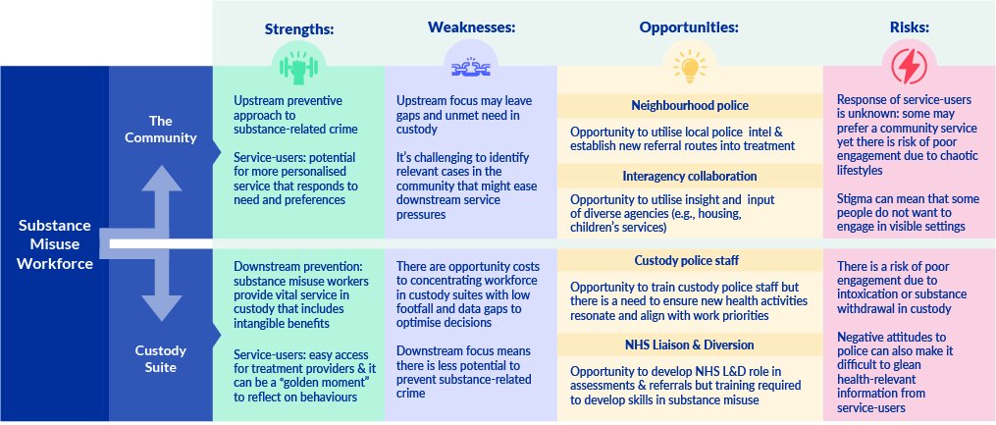
Trade-offs and uncertainties in the allocation of the substance misuse workforce

Slide 44
Findings:
Section 5: Alcohol: A proactive approach in custody?

Slide 45
Introduction
One of the aims of the initial pathway concept was to implement alcohol assessments and brief interventions in custody. This is significant because alcohol has not received as much attention historically as illegal substance and our interviewees reported considerable alcohol use and unmet need. PH Commissioning estimate that there are 170,000 problematic drinkers in Nottinghamshire versus 4000 opiate users (NHW, 2012). Understanding whether and how the police custody suite is a point of identification and intervention for possible problematic alcohol use is therefore important and could have significant implications for public health and public safety.

Slide 46
Challenges to implementing a proactive model
Alcohol was viewed as unlike other substances in that it is legal, easily accessible and there are challenges in drawing the line between what is recreational and dependent or problematic use
Custody processes for identifying and managing service-users with alcohol needs focus on heavy alcohol use to offset the immediate health threat of alcohol withdrawal: it was unclear if and how the identification of lower level but still problematic alcohol use was occurring. Trigger offences for alcohol referrals do not exist even when alcohol is implicated in drink driving, domestic violence or fights on weekend nights
One NHS L&D worker described a *proactive approach* to alcohol brief intervention in custody, involving motivational conversations to help problematic drinkers “put the dots together” and realise their alcohol use is the underlying issue. Current custody processes are not proactive in general however, relying on information provision with the onus on the detainee to ‘open up’ and request help. This necessarily involves the detainee recognising and admitting they have a problem
Who would implement alcohol brief interventions is unclear with custody police staff lacking the skills to have motivational conversations with problematic drinkers in a more proactive approach. It is unlikely that brief alcohol interventions will be effective without clearly defined roles, training and processes for identifying need at lower levels
Notes:
*Nottinghamshire Joint Health Needs Assessment, June 2022 show that 160,206 adults ‘drink at levels that pose a risk to their health’ and 4,292 of 15-64 year olds are opiate and/or crack users

Slide 47
“
Alcohol is the “poor cousin” to illegal substances:
[W]e’ve not had an alcohol strategy since 2011 so there’s very little national guidance; always financially, and from a policy perspective, alcohol has always been the poor cousin
”
“
Unmet need in custody among problematic drinkers:
Unless they say that they regularly consume alcohol or aren’t repeat offenders, then I’m sure there are people who probably would go under the radar and would be missed
”
“
The possibility of a proactive approach to alcohol management in the custody setting:
Sometimes you can put the dots together and people go, actually this is all about your alcohol use and yet that environment at the time, it may well be intense but sometimes you need those intense moments for people to take things seriously, to coalesce all the things they have been thinking in the past because things don’t all of a sudden just happen...For me, it’s a missed opportunity if you are not utilising that in some way to either educate or change behaviour: it’s an opportunity
”

Slide 48
Conclusions and Recommendations

Slide 49
Section 5: Conclusions
The proposed pathway was not implemented due to implementation challenges in the custody suite, which included service pressures and skill, confidence and role legitimacy issues among police staff
Substance use workers are a valuable resource in custody settings, although there are opportunity costs in custody suites with low footfall
There are reported gaps in substance misuse skill, knowledge and capacity among police and L&D staff
Opportunities for routes into treatment exist in both the custody suite and the community with strengths and weaknesses across these settings: the custody suite offers a reactive model whereas the community setting offers potential to prevent substance use and related crime through upstream intervention. Both settings present opportunities and challenges to engaging service-users
Processes for identifying and managing problematic drinking in custody is unclear with missed opportunities for preventing future alcohol-related harms. The delivery and effectiveness of brief alcohol interventions requires further consideration
There is opportunity to develop treatment pathways in the community through joined-up working among neighbourhood police, CGL and other agencies, such as youth services and probation

Slide 50
Recommendations (1): service development
This evaluation identified areas service development including:
The need for inter-agency collaboration to, first, develop a shared understanding of a public health approach in criminal justice settings, including what downstream and upstream mean to the various agencies involved; and, second, to establish processes, roles and relationships for facilitating this
Agreement on staff roles and the optimum use of the substance misuse workforce. Regarding the latter, two options should be considered:
  A roaming CGL worker, able to attend the custody suite at high footfall times
  A substance misuse worker within L&D
The need for training in substance misuse and referral processes for police and L&D
Clarity on the management of problematic drinking, including the role of brief alcohol interventions and who is to both receive and implement them
Further development of community routes into treatment and the organisational relationships for underpinning these, including CGL, neighbourhood police, youth services, housing and probation

Slide 51
Recommendations (2): data collection and service-users
There is a need to consider ways of generating, analysing and using existing or new data to inform service delivery and development:
Sharing of heat maps on high footfall times to inform decisions on when substance misuse workers attend custody
Data on the amount of substance and alcohol related crime and service user need to support commissioning decisions and assist in the identification of clients for referrals and support
Follow-up data on service user experience and outcomes for use in service evaluation and the motivation of frontline staff
Enhance understanding of and integration between police (NICHE) and drug and alcohol (CRIS) service databases
Service-user involvement:
While involving service-users in service redesigns is challenging in the criminal justice sector, there is a vital need to obtain service-users views on appropriate entry points into treatment and interventions. Engagement with service users should be sought at all levels of service delivery and commissioning on an ongoing basis

Slide 52
References
Allen, G., Tunnicliffe, R., 2021. Drug Crime: Statistics for England and Wales. House of Commons library
Best, D., Noble, A., Stark, M., & Marshall, E., 2002. The role of forensic medical examiners and their attitudes on delivering brief alcohol interventions in police custody. Criminal Behaviour and Mental Health, 12(230-235)
Blakeborough, L., Richardson, A., 2012. Summary of findings from two evaluations of Home Office Alcohol Arrest Referral pilot schemes. Summ. Find. Two Eval. Home Off. Alcohol Arrest Ref. Pilot Schemes Research Report 60
Disley, E., Gkousis, E., Hulme S., Morley, K., Pollard, J., Saunders, C., Sussex, J., Sutherland, A., 2021. Outcome of the evaluation of the national model for Liaison and Diversion Services. RAND Europe
HM Government, 2021. From harm to hope: A 10-year drugs plan to cut crime and save lives.
McGovern, R., Crowe, L., Kaner, E. Containment and care? A qualitative interview study exploring police custody staff views about delivering brief alcohol interventions to heavy drinking arrestees, Drugs: Education, Prevention and Policy, 27
McSweeney, T., Hughes, C., Ritter, A., 2018. The impact of compliance with a compulsory model of drug diversion on treatment engagement and reoffending. Drugs Educ. Prev. Policy 25, 56–66.
Nottinghamshire Health & Wellbeing board, June 2012. Nottinghamshire Joint Strategic Needs Assessment.
Page, G., 2019. Rapid Evidence Review: Alcohol Interventions and the Criminal Justice System. Alcohol Change UK.
Skodbo, S., Brown, G., Deacon, S., Cooper, A., Hall, A., Millar, T., Smith, J., Whitham, K., 2007. The Drug Interventions Programme (DIP): addressing drug use and offending through “Tough Choices.” Home Office
Sondhi, A., Eastwood, B., 2021. Assessing diversionary approaches for drug misusers in police custody in London: engagement and treatment outcomes as part of the Drug Intervention Programme. Addict. Res. Theory 29, 223–230.

Slide 53
Thank you from PHIRST South Bank
Email: phirst@lsbu.ac.uk

